Slide 1
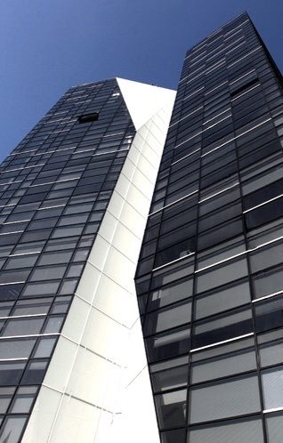
National Bureau of Enforcement
/
Ministry
of Justice
Functions & Structure
Presented by
Nick Melia

Slide 2

C o n t e n t
I
National Bureau of Enforcement
II
Structure & Services
III
Ongoing Projects

Slide 3
National Bureau of Enforcement
Head
Dep. 1
Bureaus
Bailiffs
Dep. 2
Admin.
2008 Reorganization
Financing
Set up as Legal Entity of Public Law under the supervision of Ministry of Justice of Georgia
Former Subsidies from state budget consisted of 3 million units of Georgian National Currency–Lari (Appx. 1.8 mln. dollars)
Now functions on self-financing basis; Annual budget compounds 26 million Lari
Central Office
8 Regional Enforcement Bureaus
Employ 373 persons
151 Administrative Officers
140 Enforcement Officers
55 Tax Officers
27 Enforcement Policemen
15 Property Appraisers

Slide 4





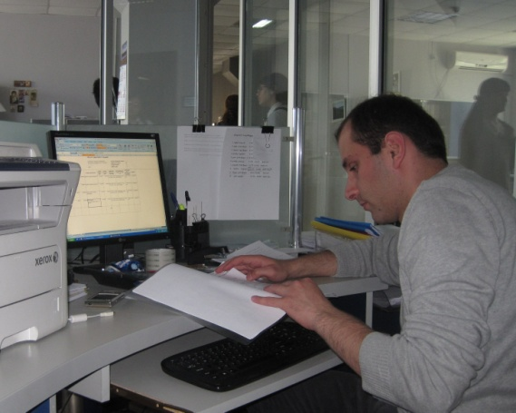
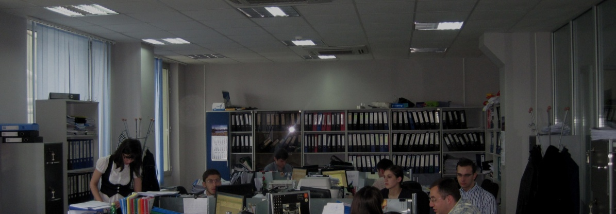
S t r u c t u r e
Division of Labour
Between Bailiffs
8 local territorial subdivisions
of the bureau
Enhanced communication between regional divisions
Senior Bailiff-
i.e. enforcement officer, responsible for office work
Junior Bailiff-
i.e. Inspector, carries out duties through physically
searching for debtors and their property
Batumi Service Hall
Tbilisi Service Hall

Slide 5
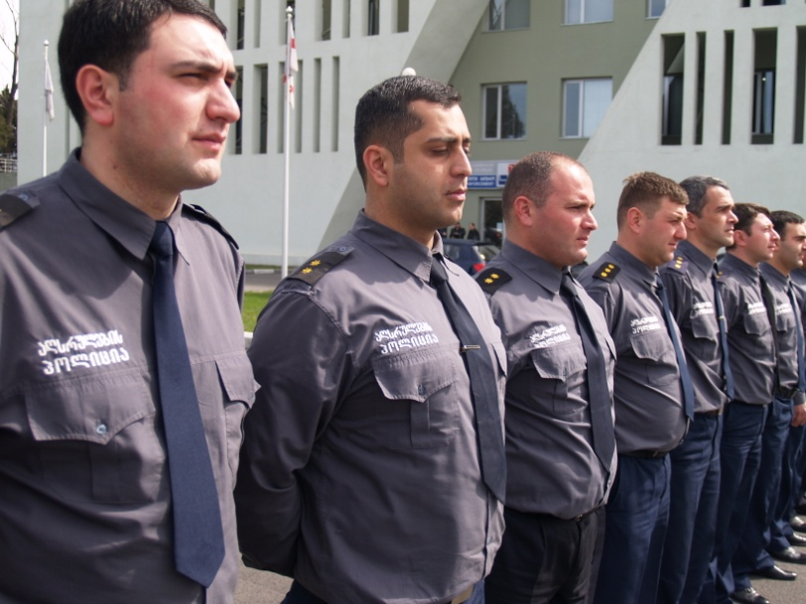
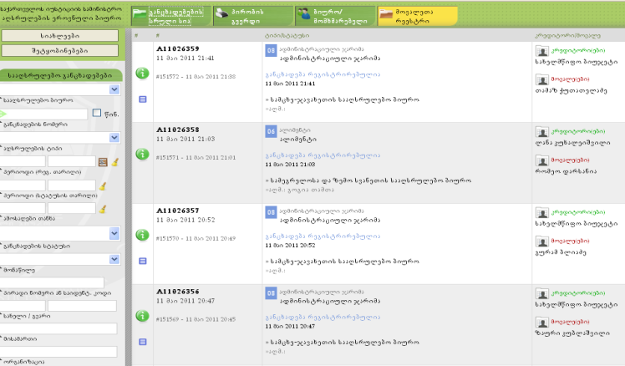
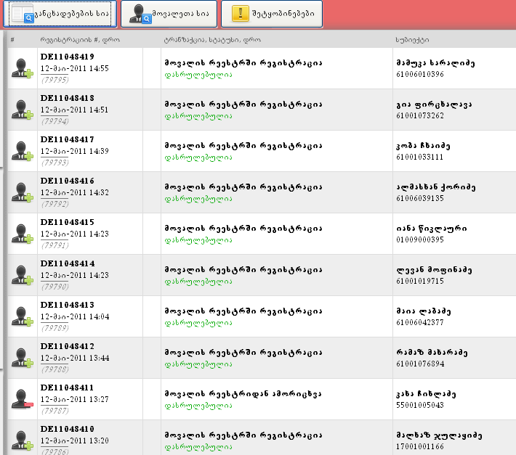

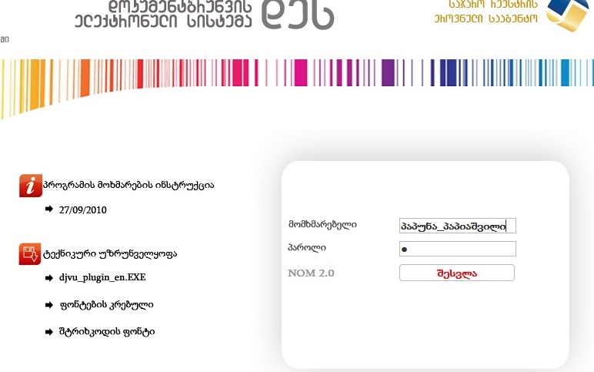

Various Services
Introduced IT Solutions
Enforcement Police
Electronic Program for Enforcement Proceedings
Debtor Registry
E-program for document circulation
Tasks:
Give hand to bailiff during enforcement
Maintain order during enforcement procedures
Carry out evictions
Enforcement Police
Tax Office
Service of Evaluators
Tasks:
Sequestration of the property on the basis of the application of taxing institutions
Tasks:
Assess the property for forcible auction
Key feature of time and money efficient services

Slide 6


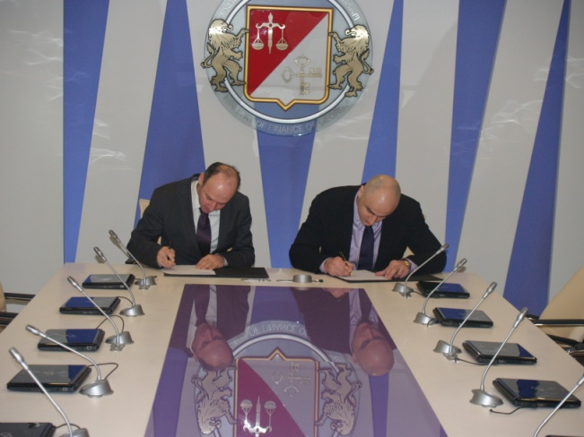
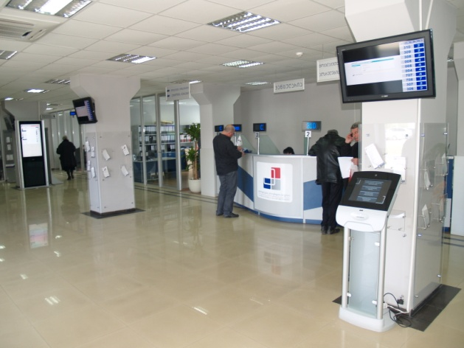
Elements of Modern Services
Free Legal & General Consulting
Call Center
System of Queue Management
New Comfortable Services for Corporate Customers

Slide 7
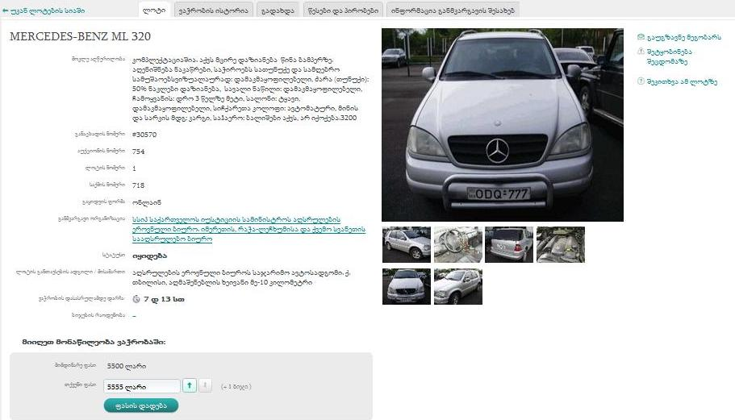

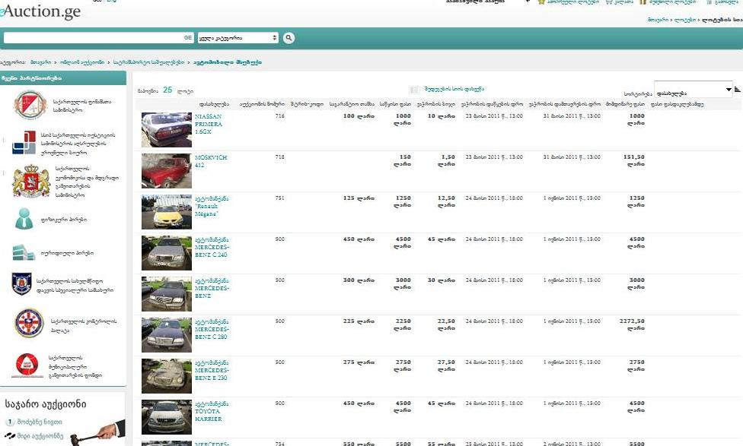
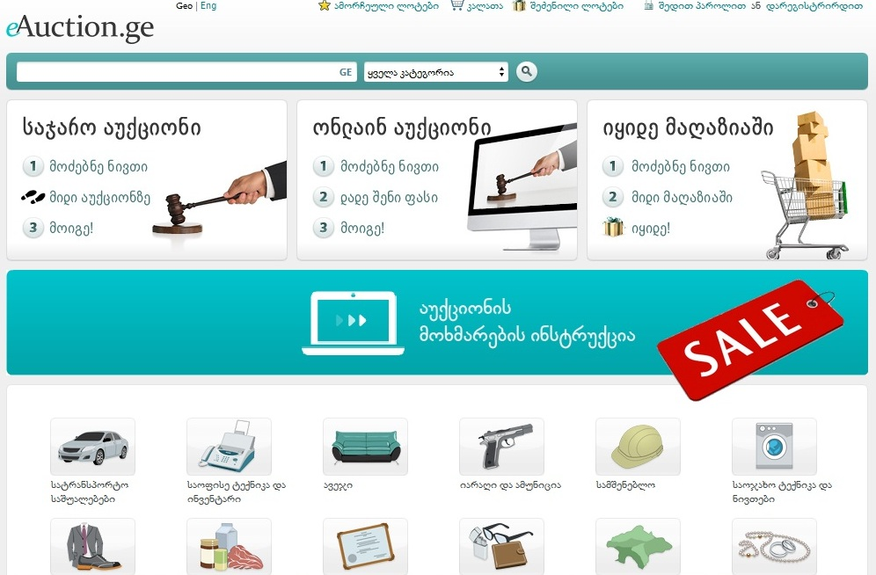


Service of Online Trade
Example of searching for the lot
World widely approved method
Best way to attract buyers
Easy and flexible system
Participating in auction is possible from
every corner of the Earth

Slide 8

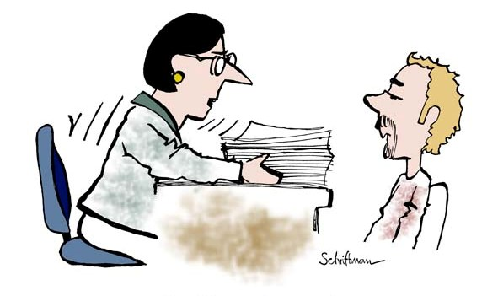


O n g o i n g P r o j e c t s
E-Justice
Direct exchange of information with judicial institutions through IT solutions
Enforcement without Court Hearings (Time & Money Efficient for Customers)
Shortening of bureaucratic hindrances
Service of Reconciliation
Widened Evaluation Service

Slide 9


Thank you for attention!
Questions...

